Slide 1
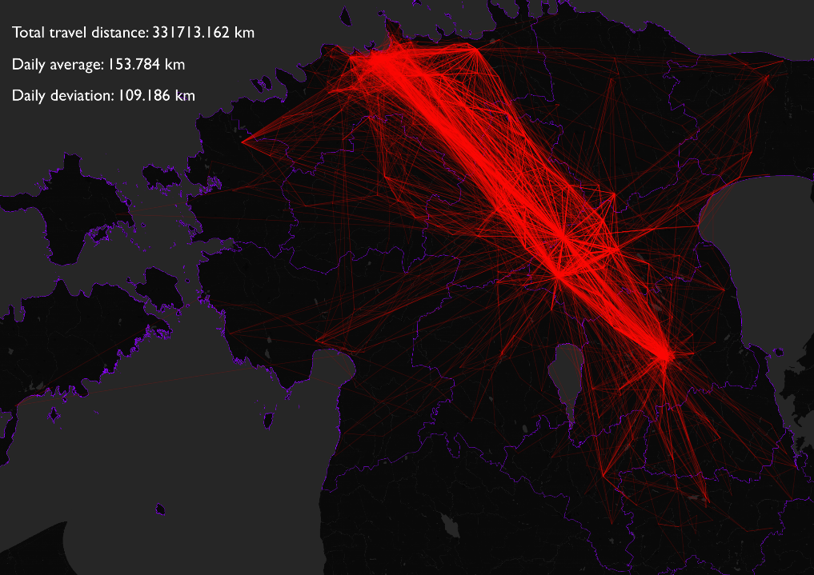

Slide 2
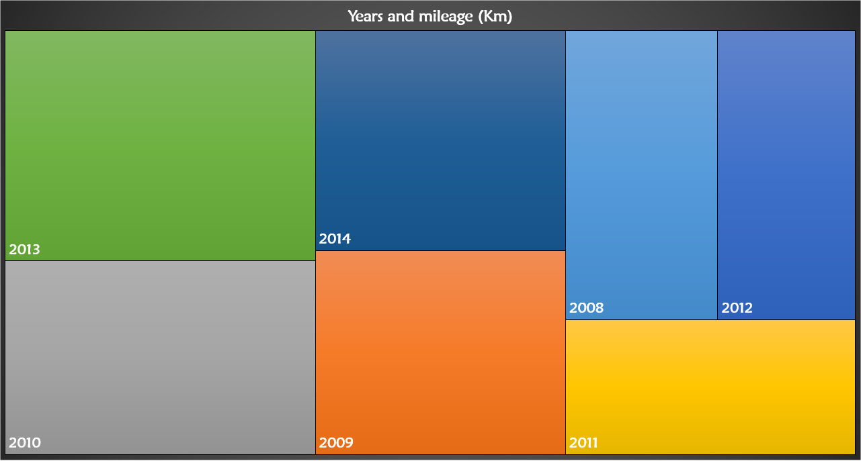
65 708
50 694
40 486
36 559
55 309
47 012
35 942
Total 331 713
Mean 47 387
SD 10 038

Slide 3
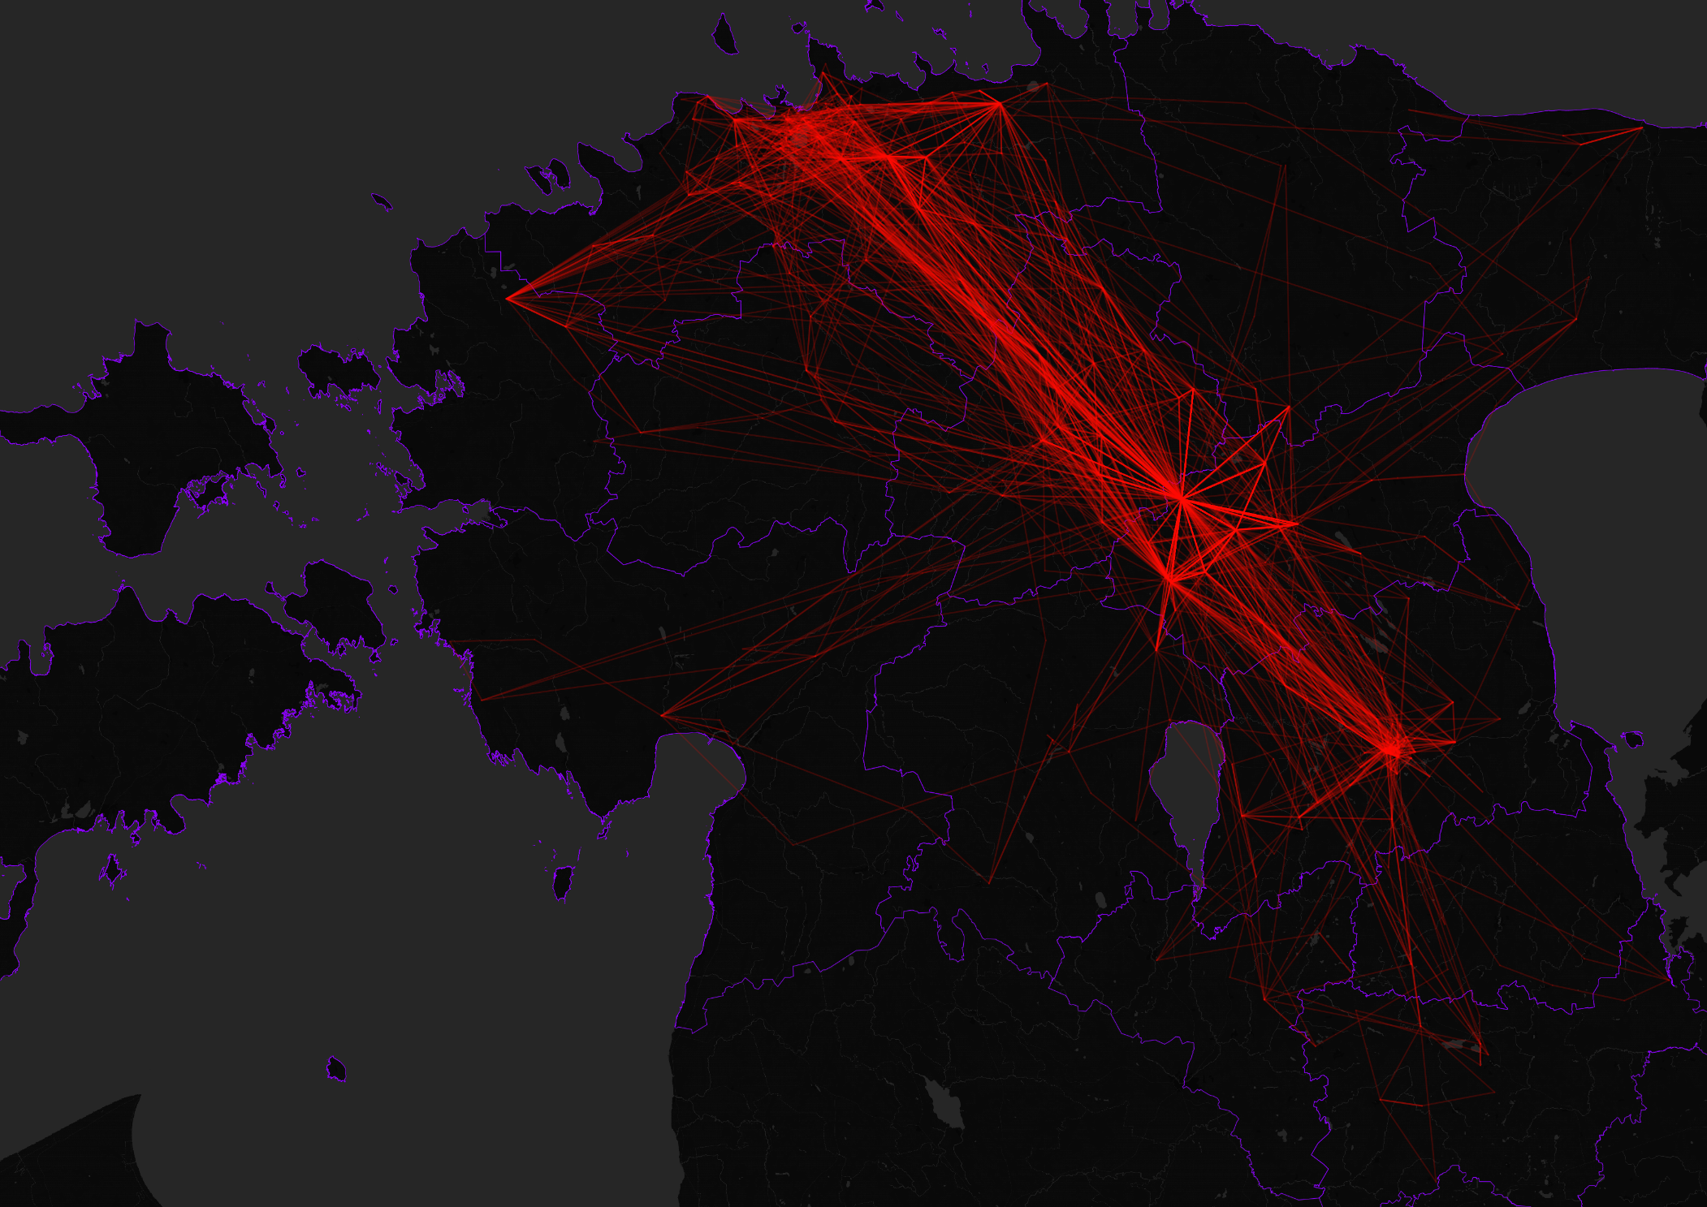
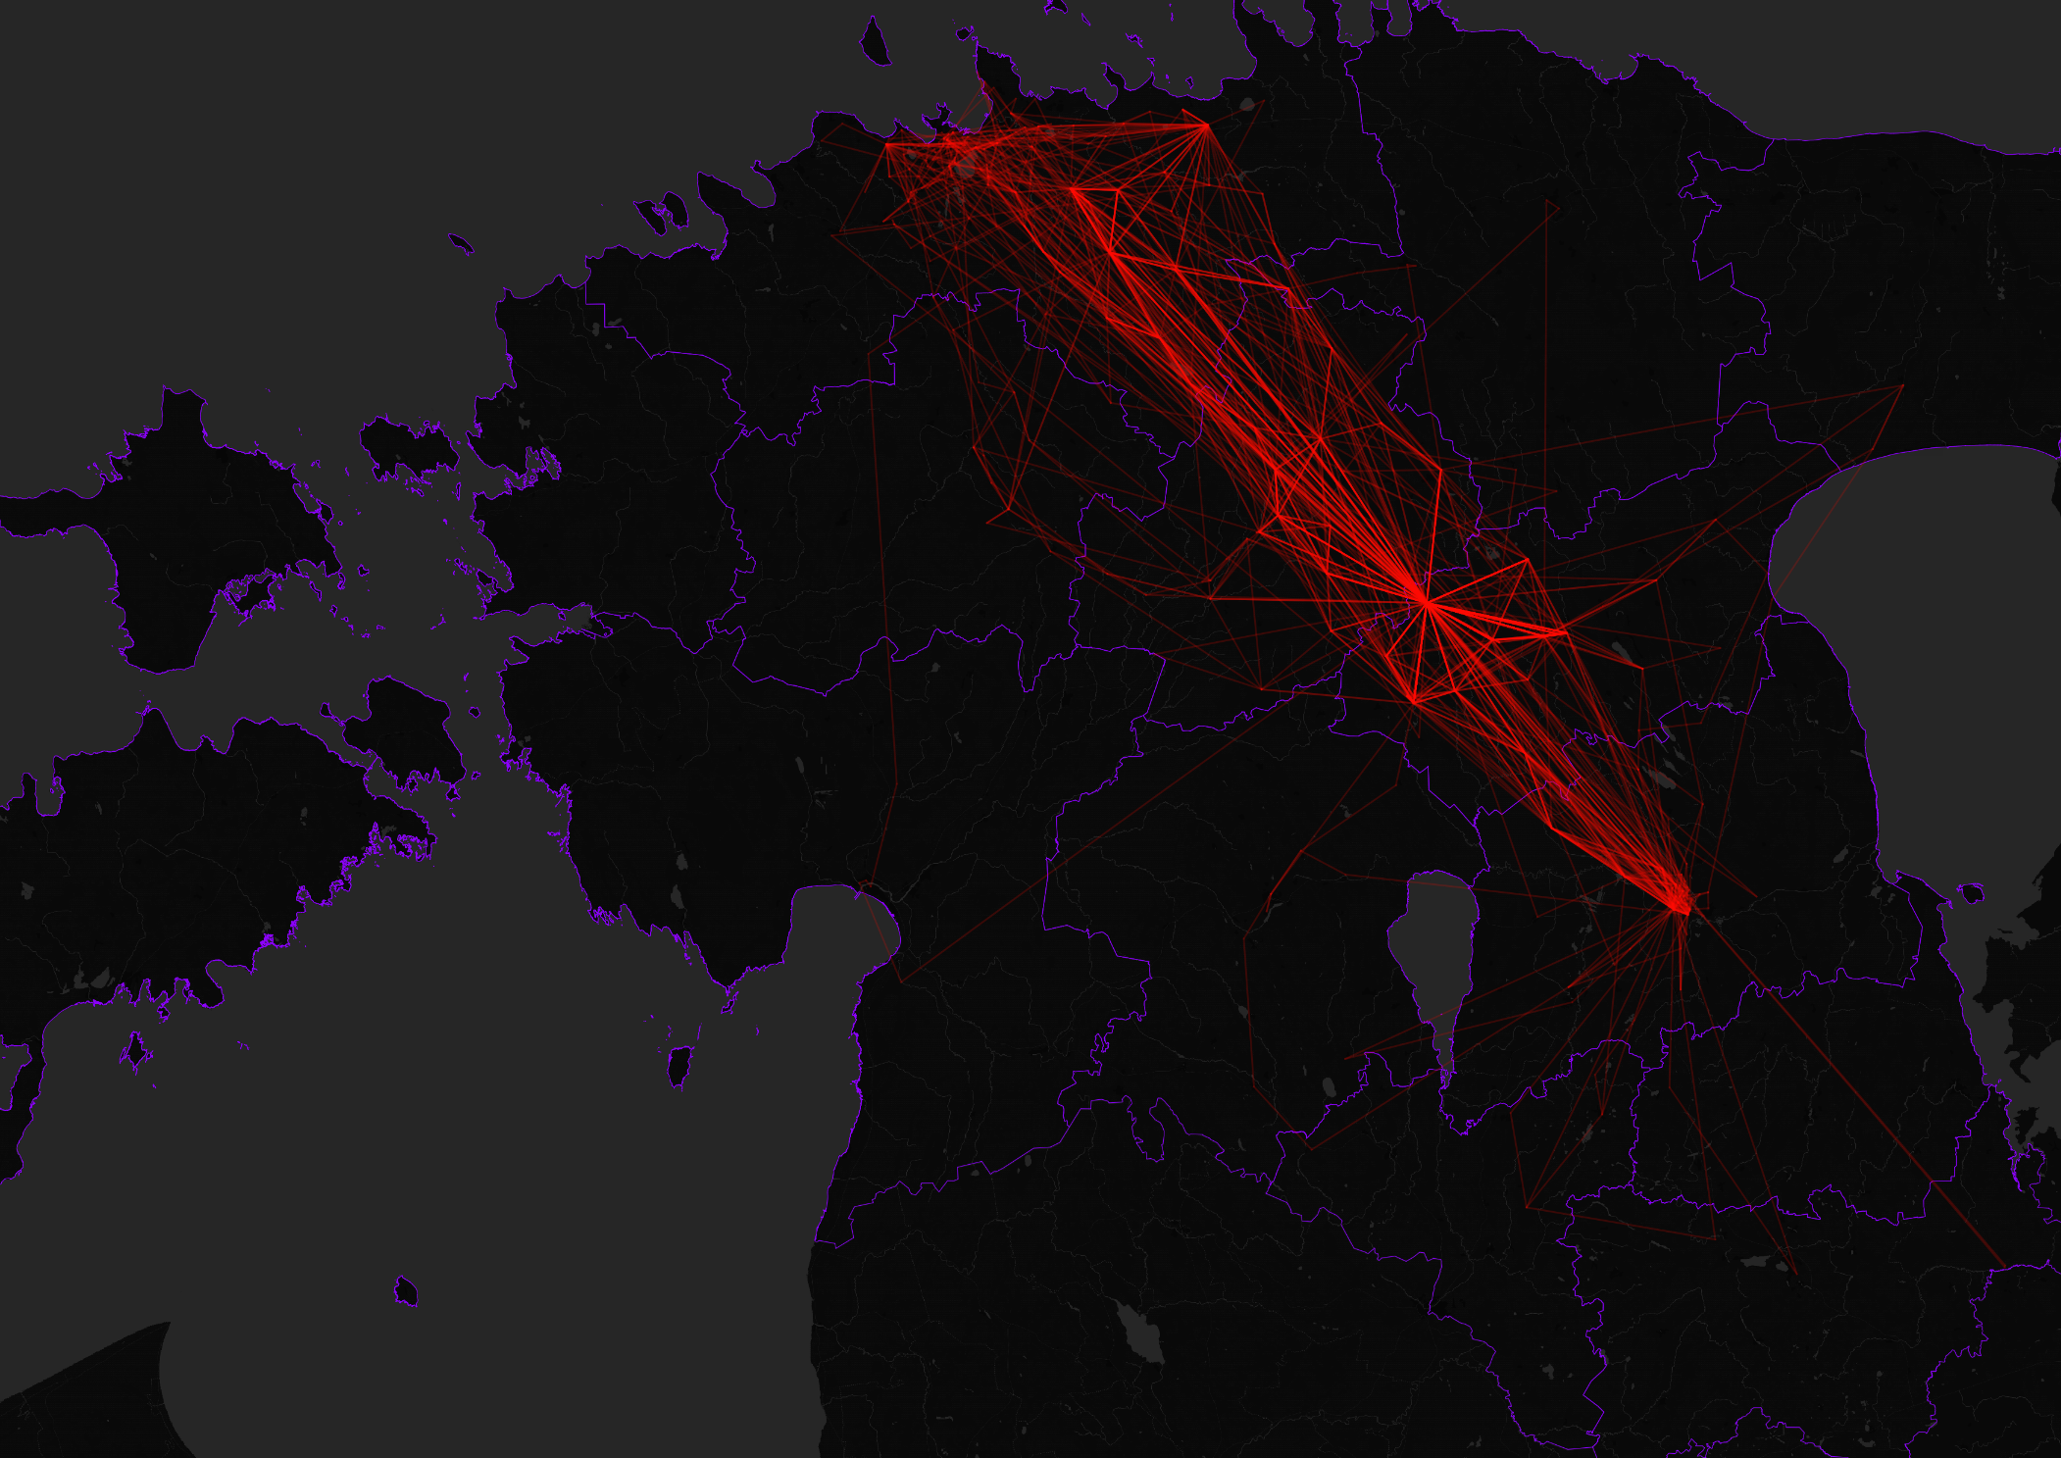
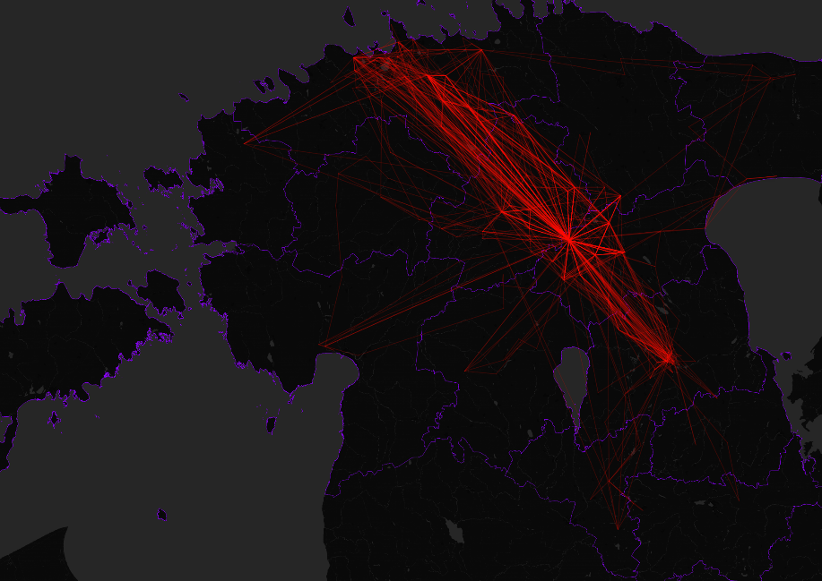
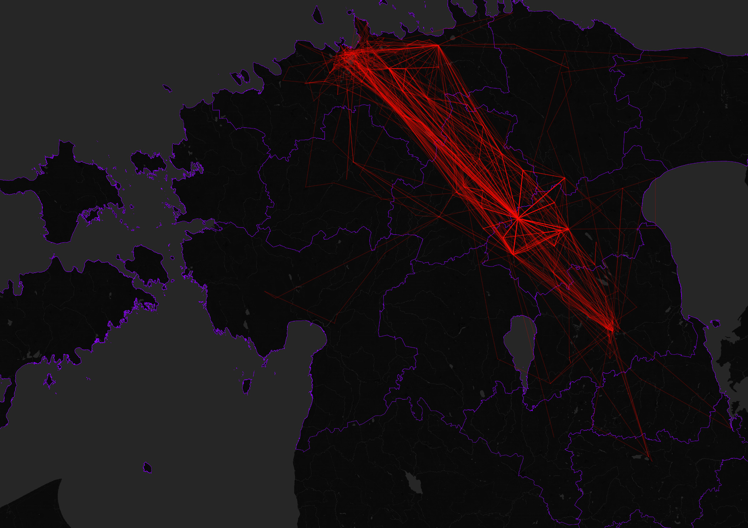

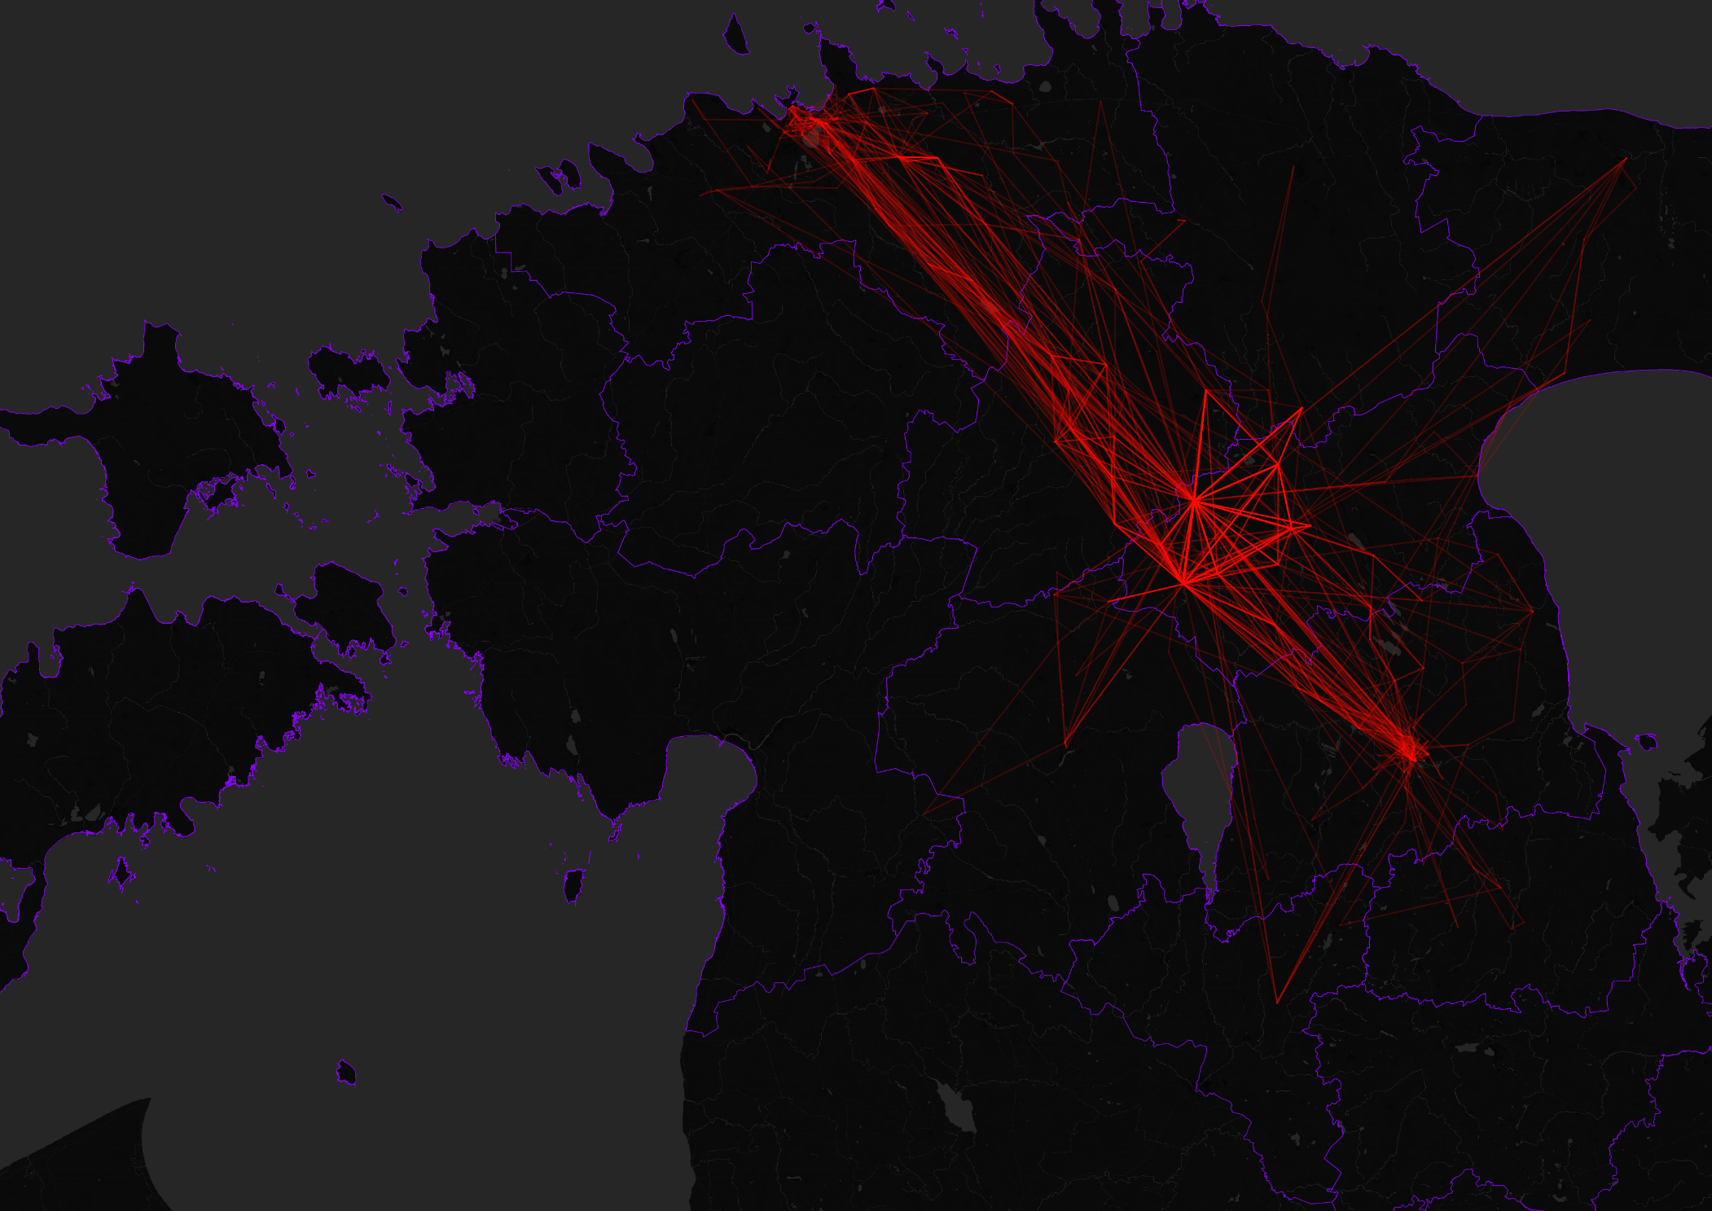
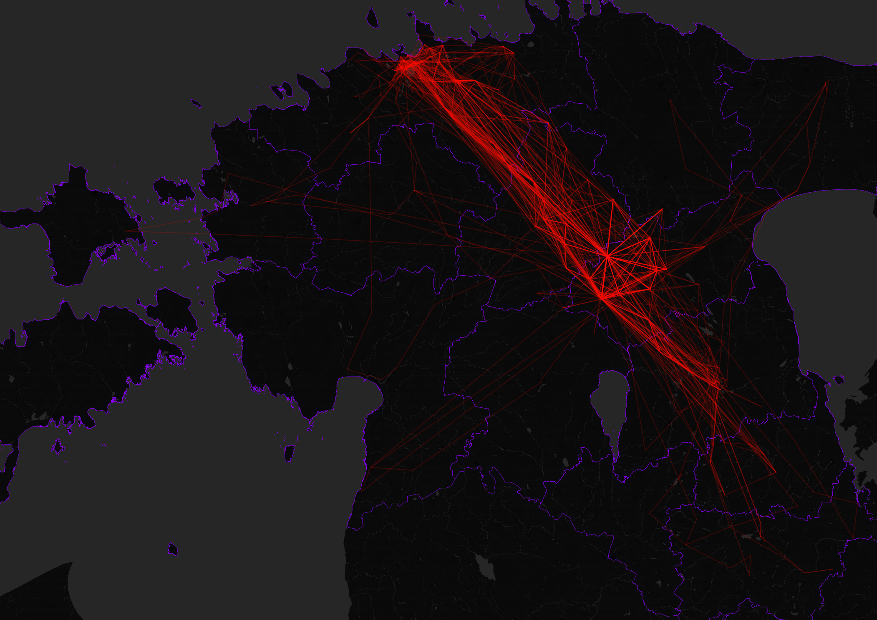
Yearly Spatial Mobility
2014
Yearly Spatial Mobility
2013
Yearly Spatial Mobility
Yearly Spatial Mobility
Yearly Spatial Mobility
2012
2010
Yearly Spatial Mobility
2011
Yearly Spatial Mobility
2008
2009

Slide 4
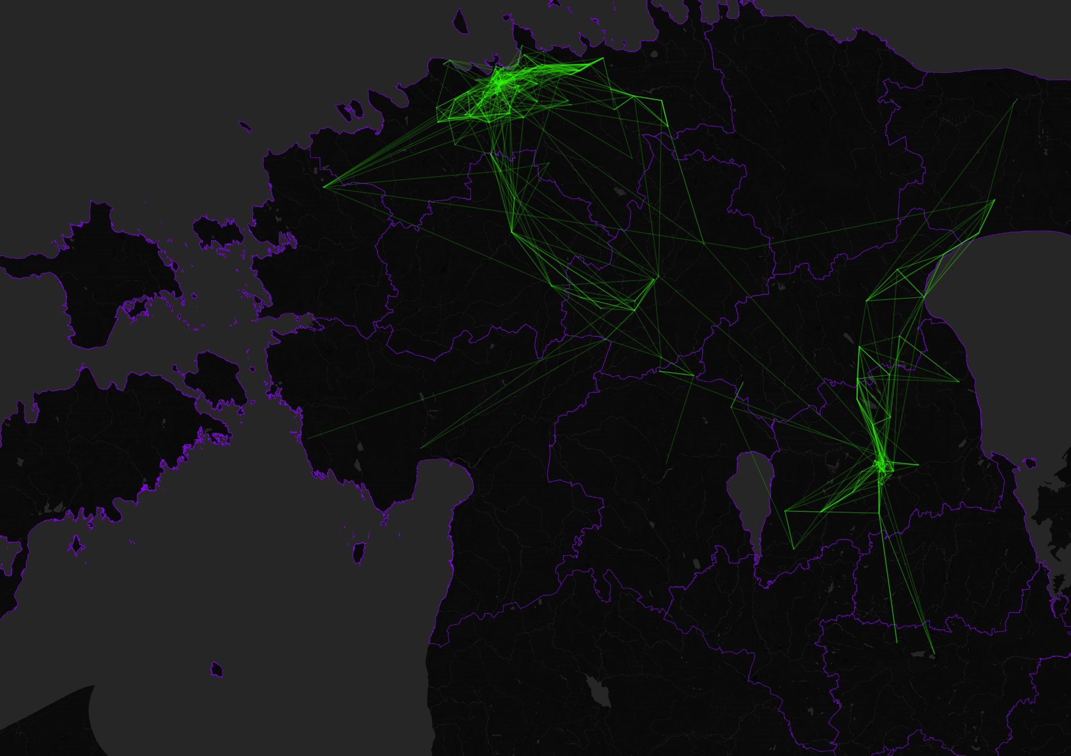
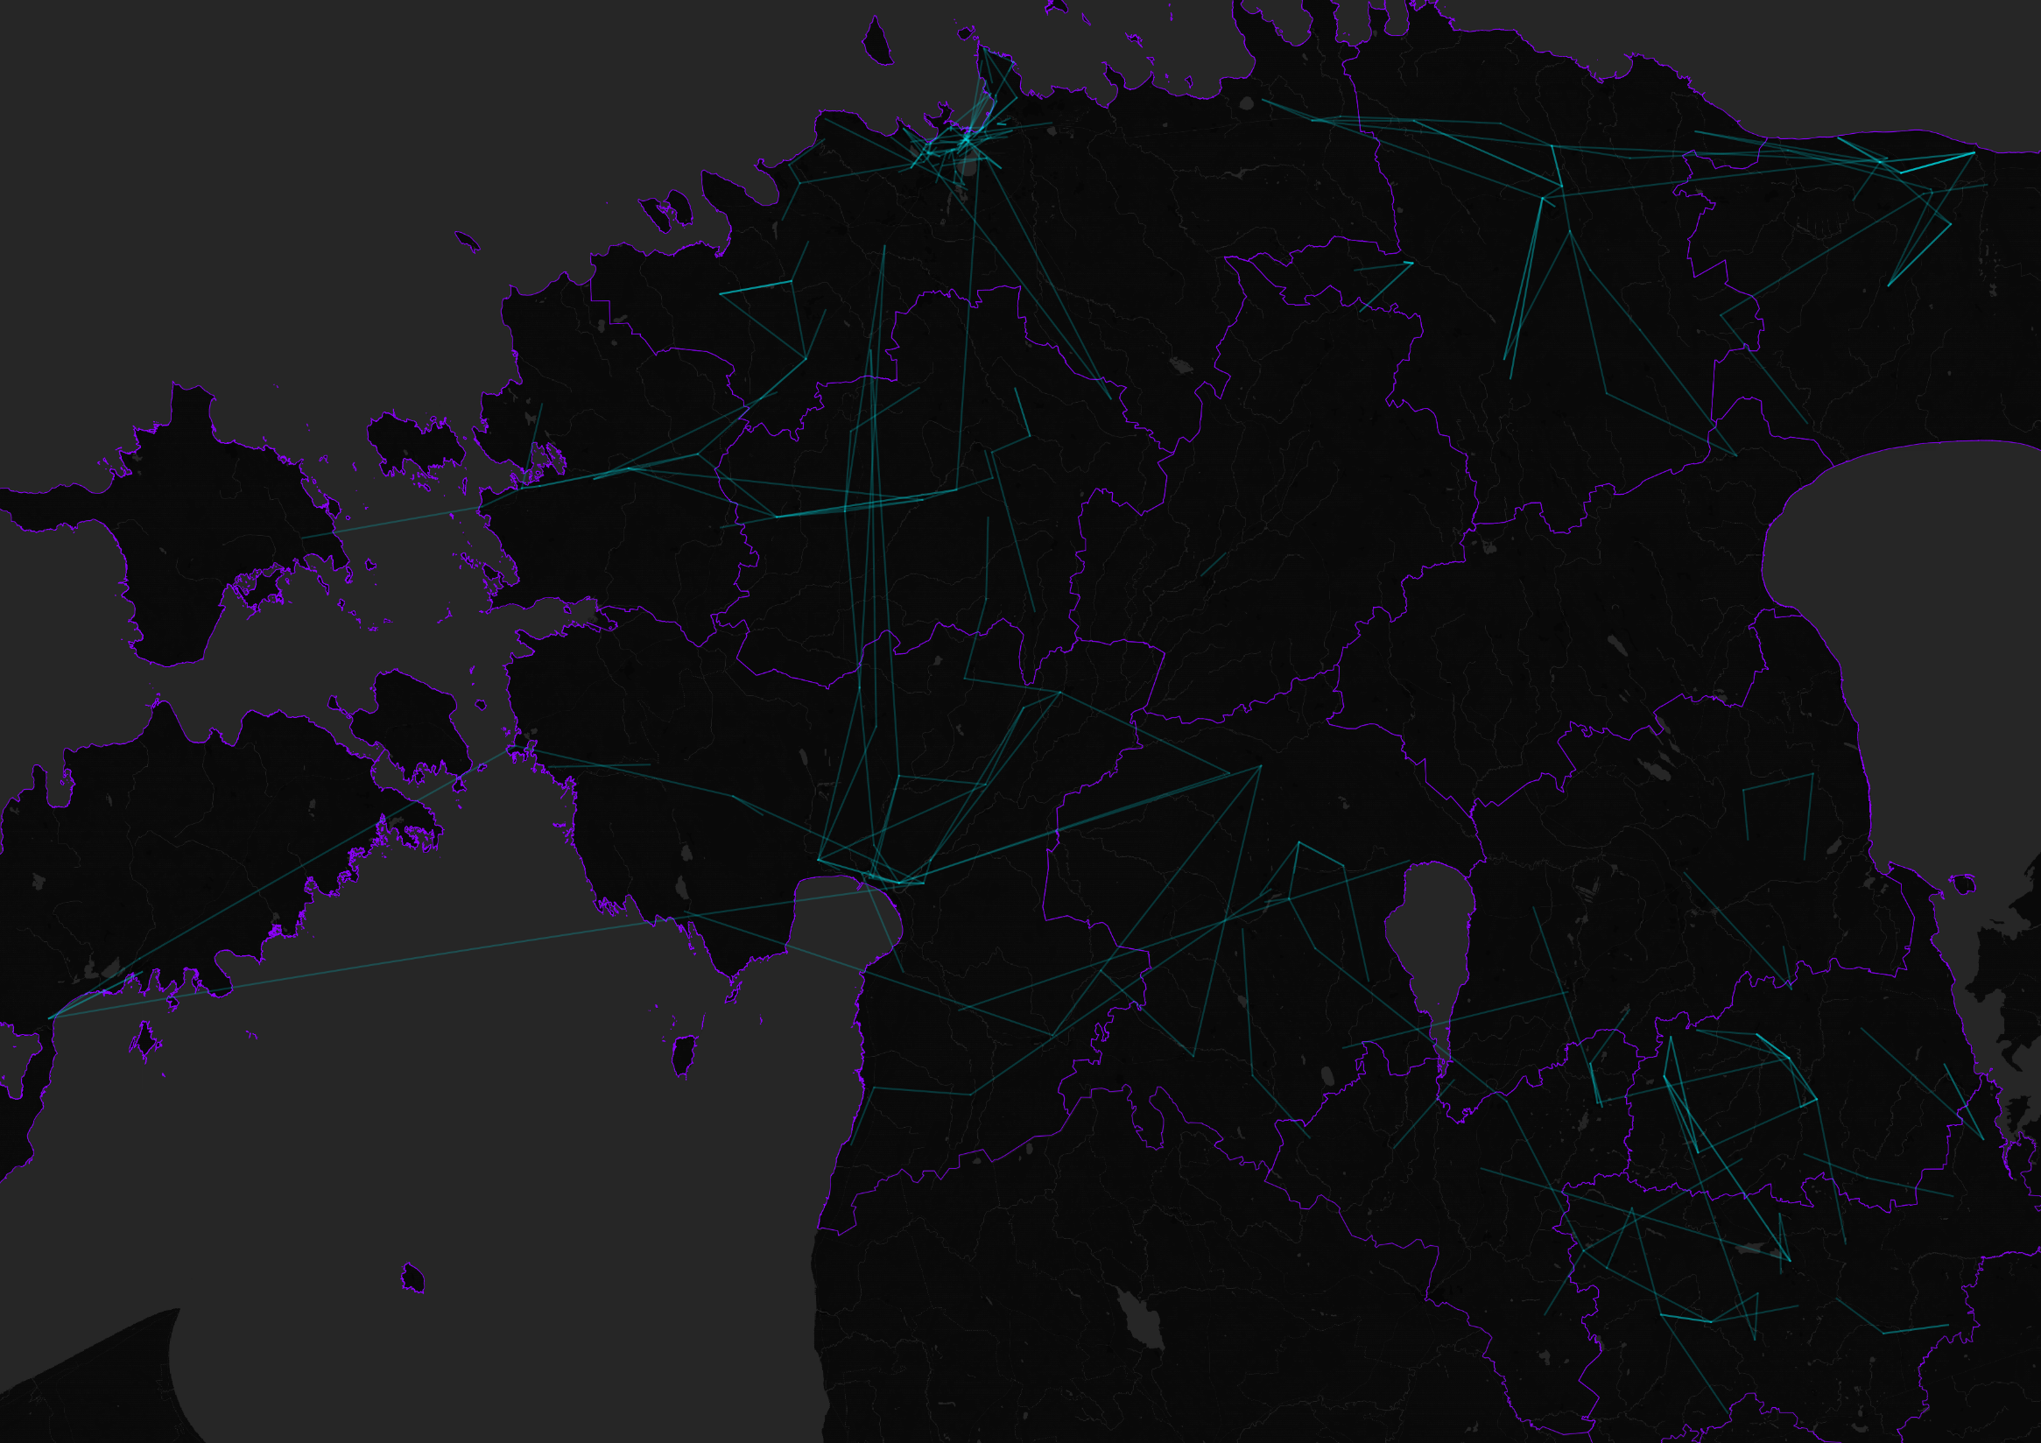
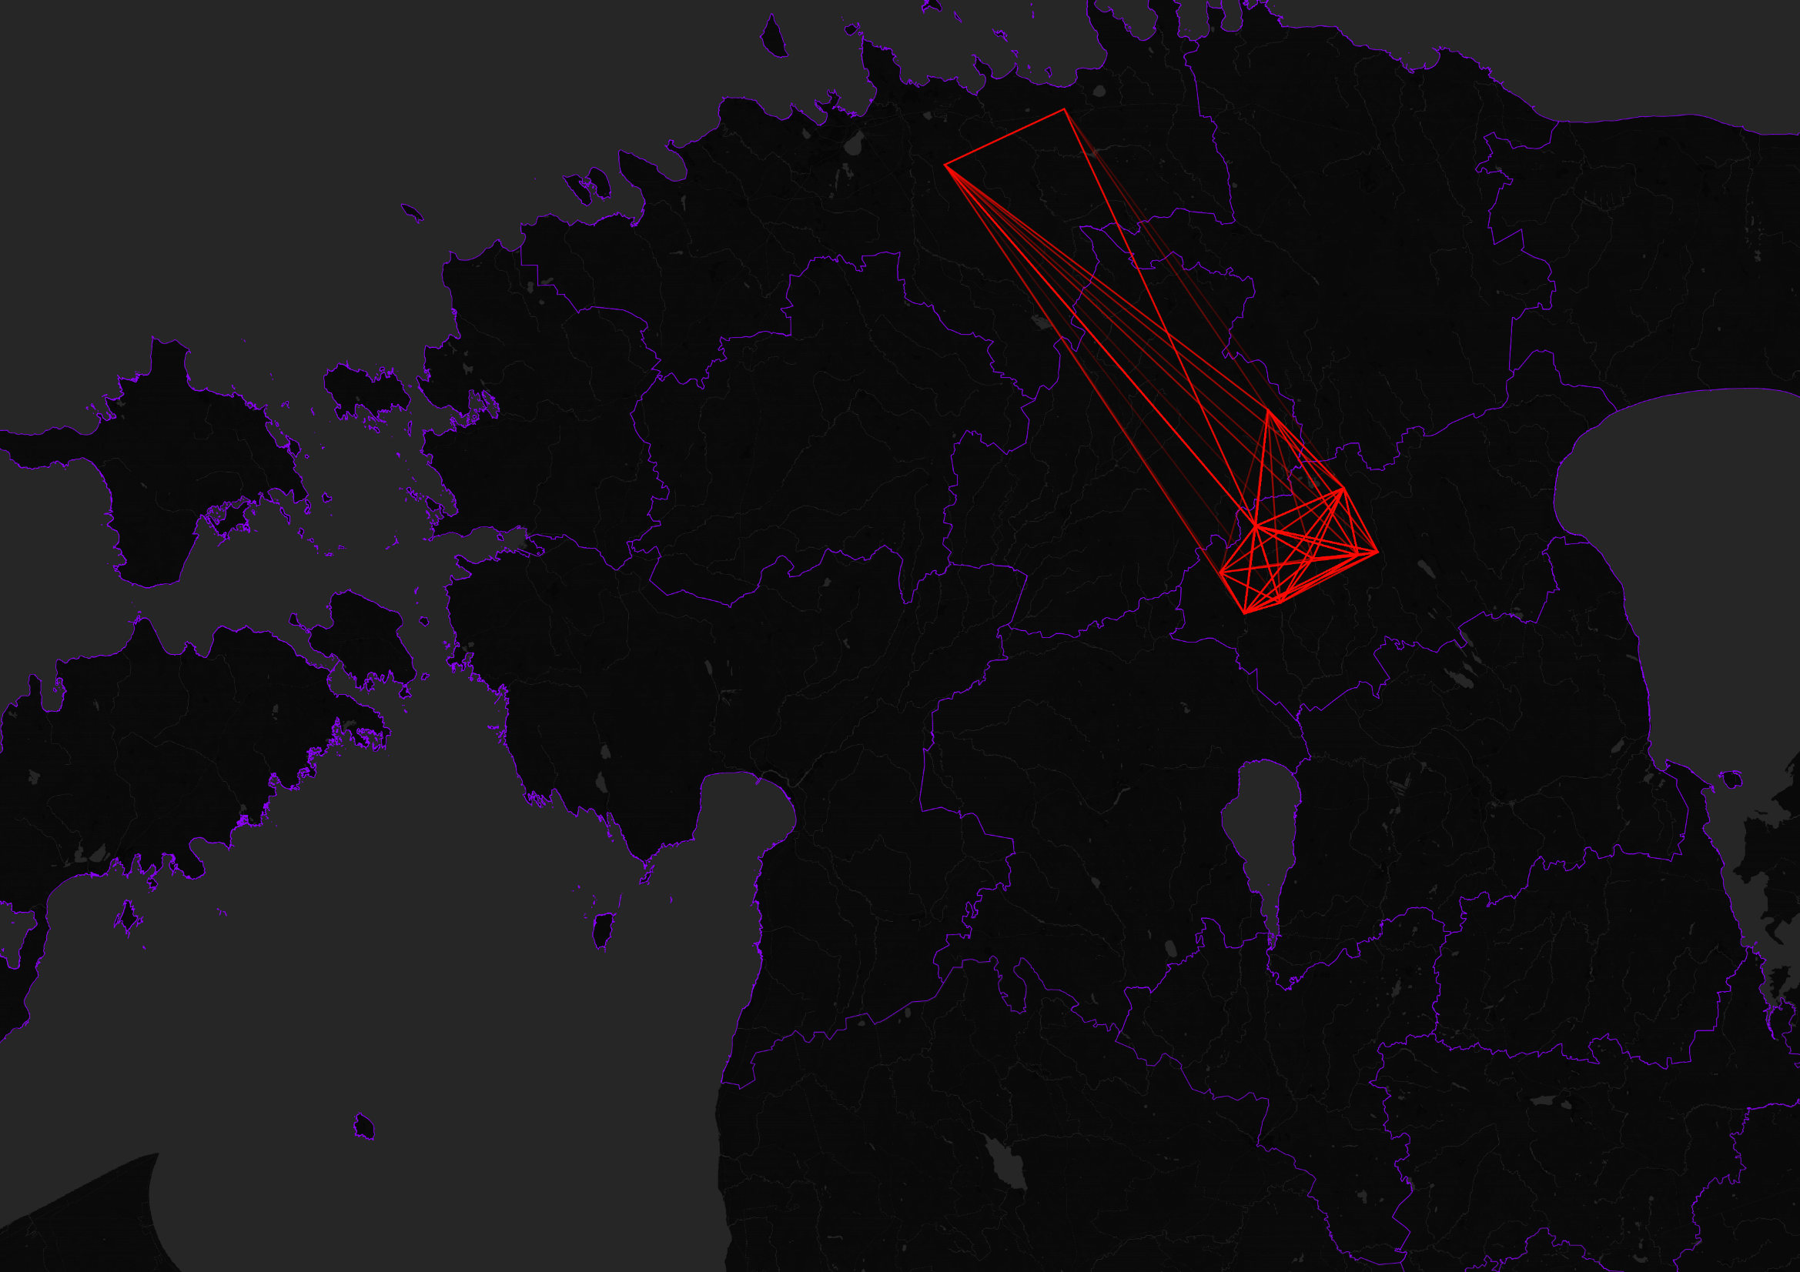
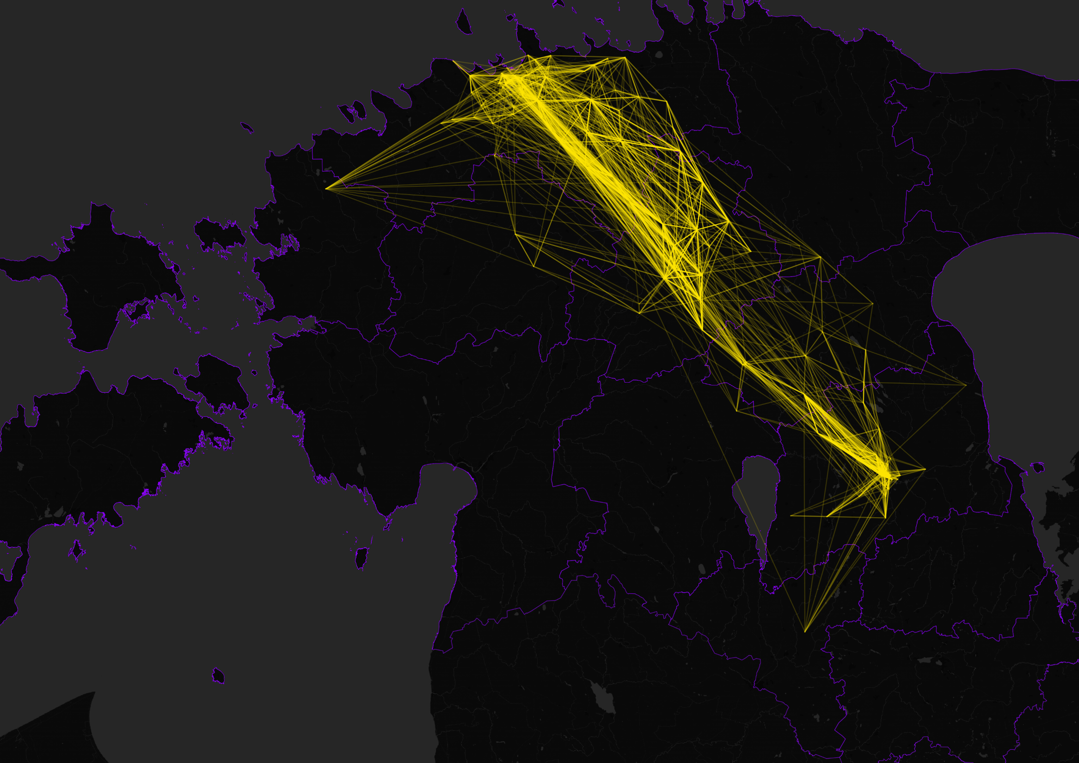
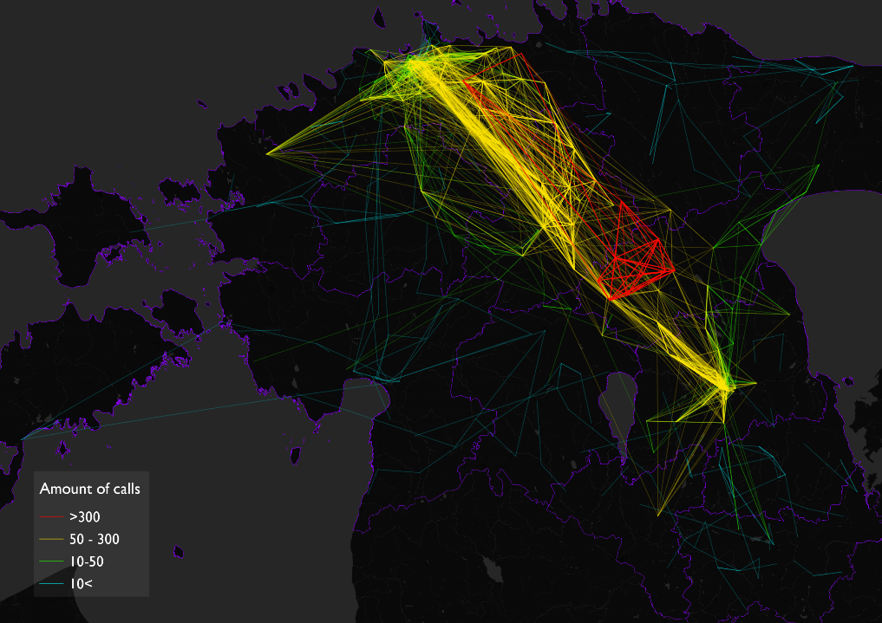
Number of Calls
Number of Calls
Number of Calls
Number of Calls
Number of Calls
>300
Between 50 and 300
Between 10 and 50
Less than 10

Slide 5
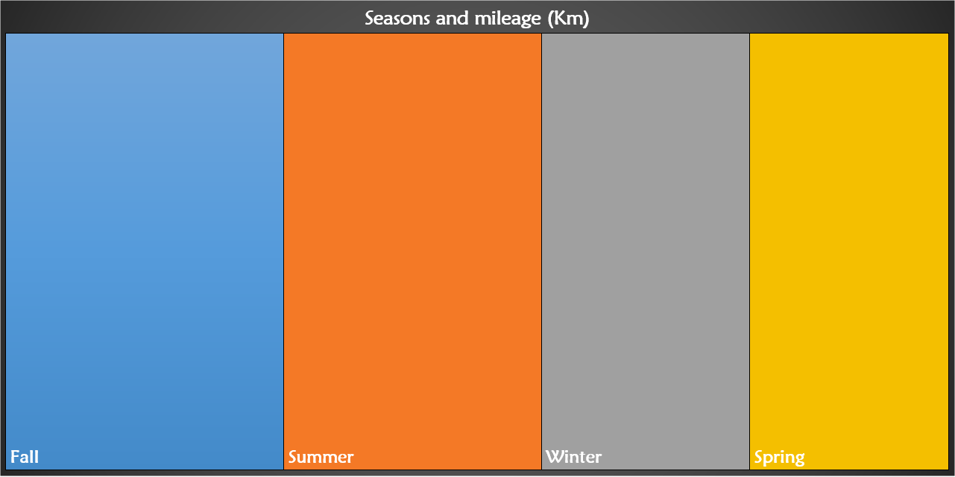
97 898
90 619
73 283
69 912
Total 331 713
Mean 82 928
SD 11 680

Slide 6
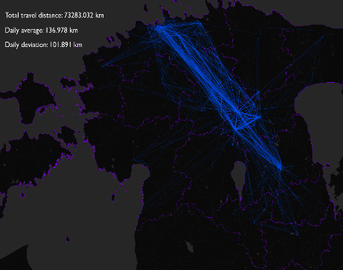
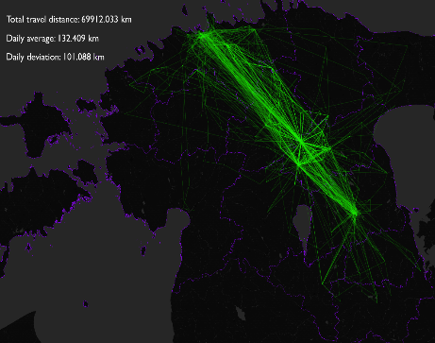
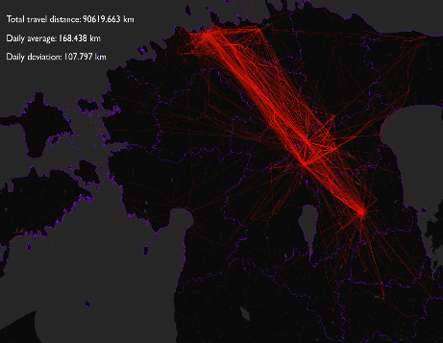
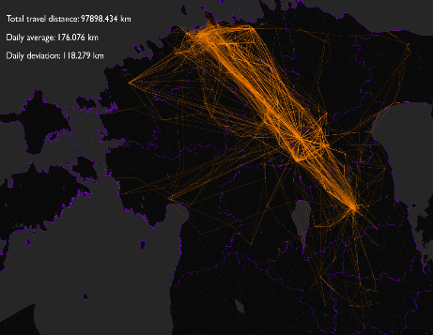
Mileage in seasons per day type
287 497
44 215

Slide 7
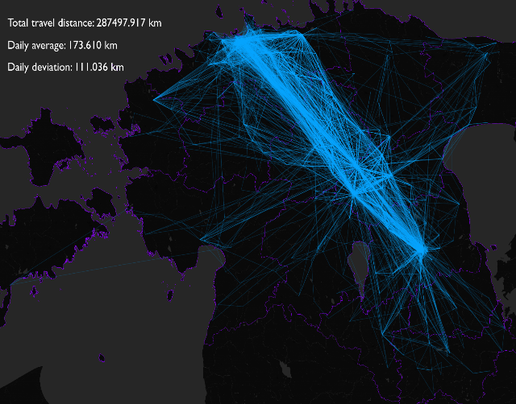
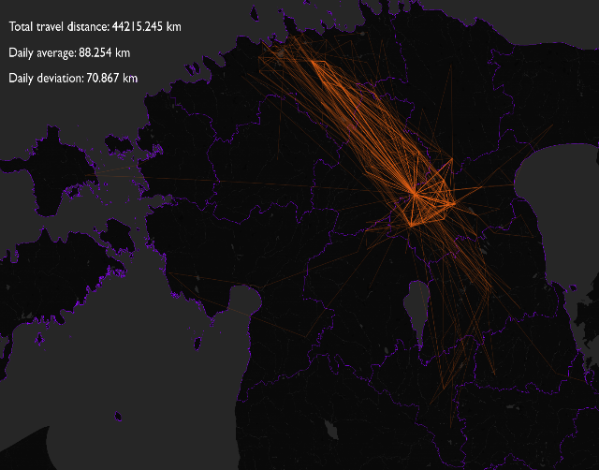
Weekdays
Weekends

Slide 8
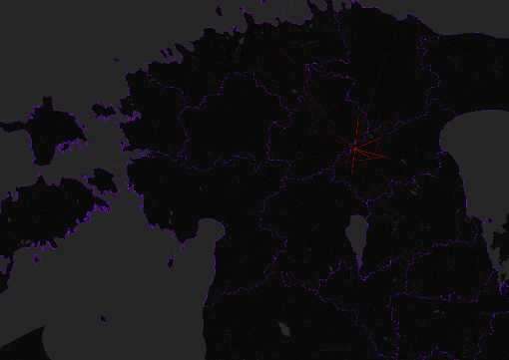
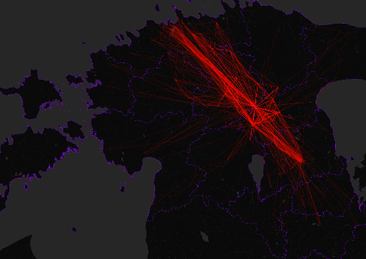
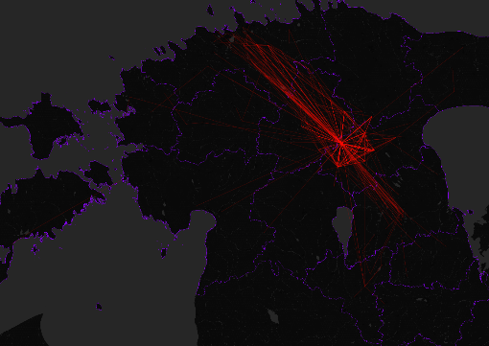
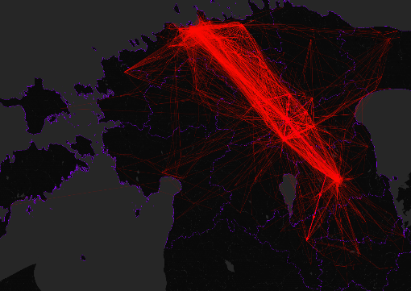
Night
Morning
Evening
Day

Slide 9
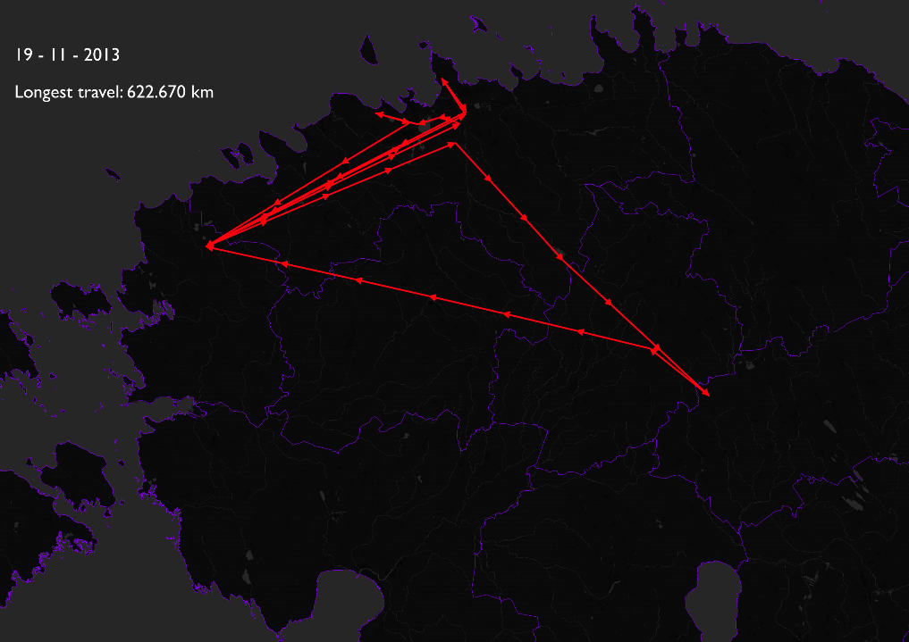
Particular dates
19 – 11 - 2013
Longest travel
622.670 Km

Slide 10
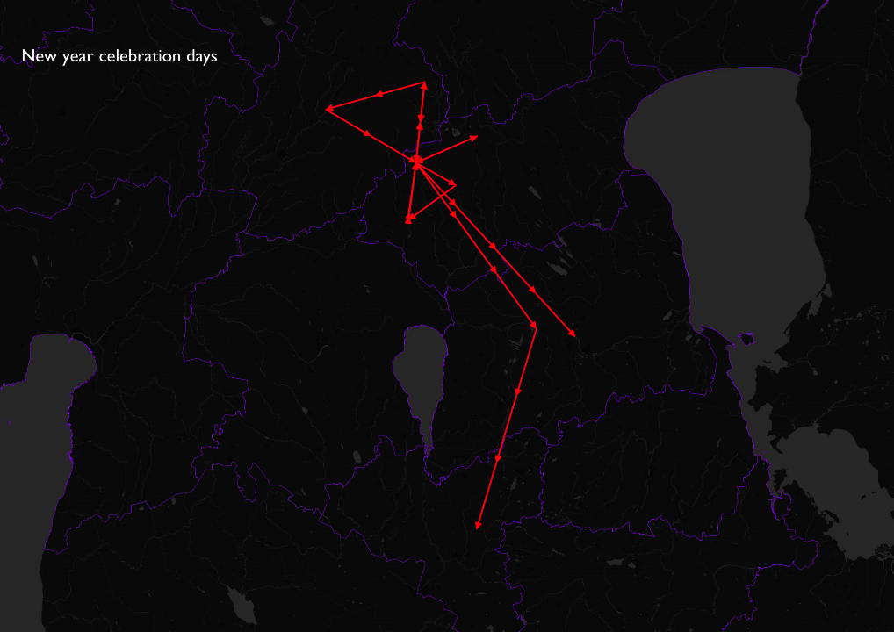
Particular dates
New year celebration days

Slide 11
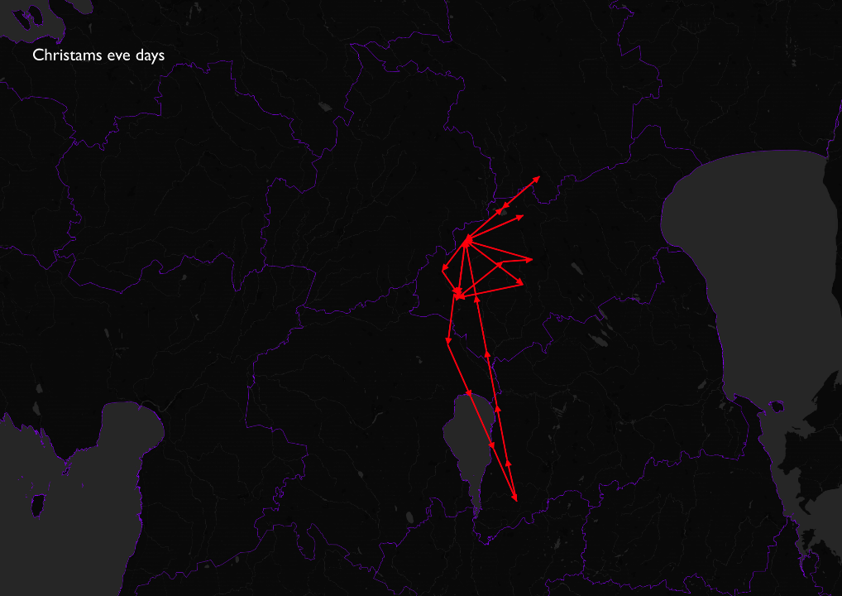
Particular dates
Christmas eve
days

Slide 12
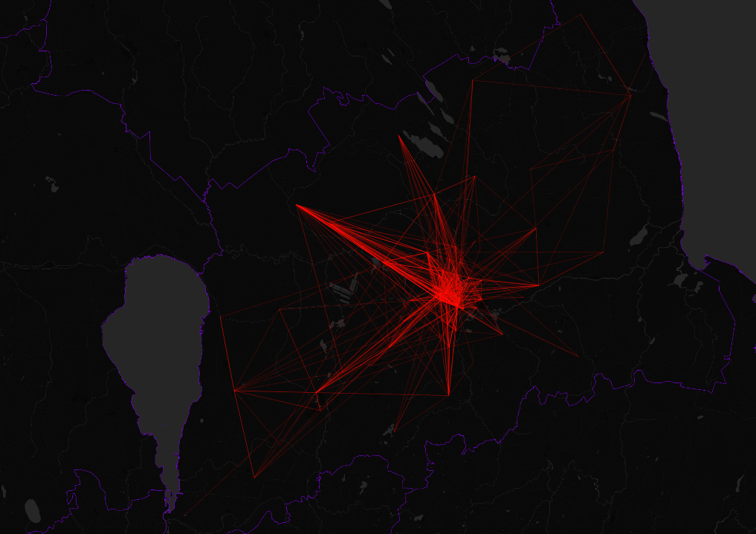
Tartu

Slide 13
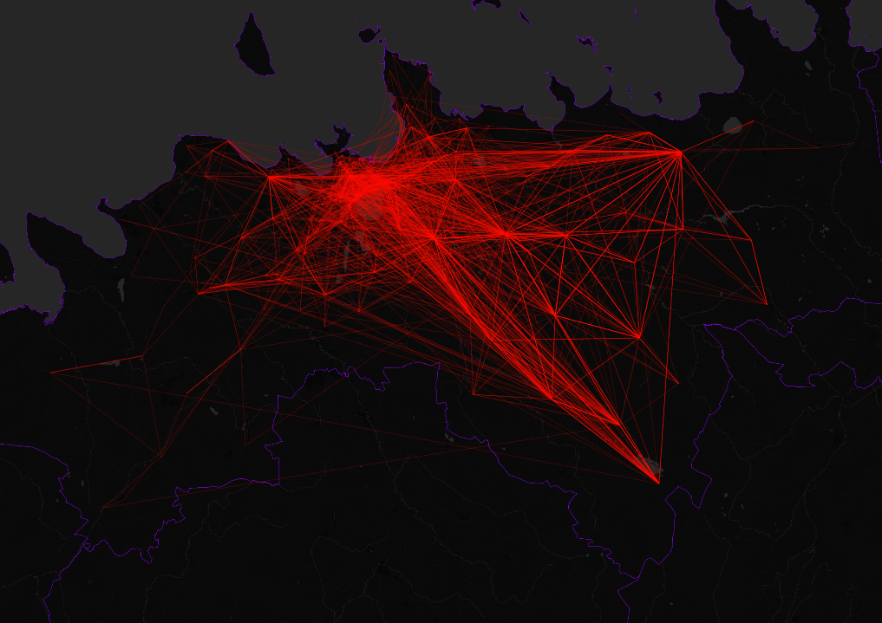
Tallinn : Weekday

Slide 14
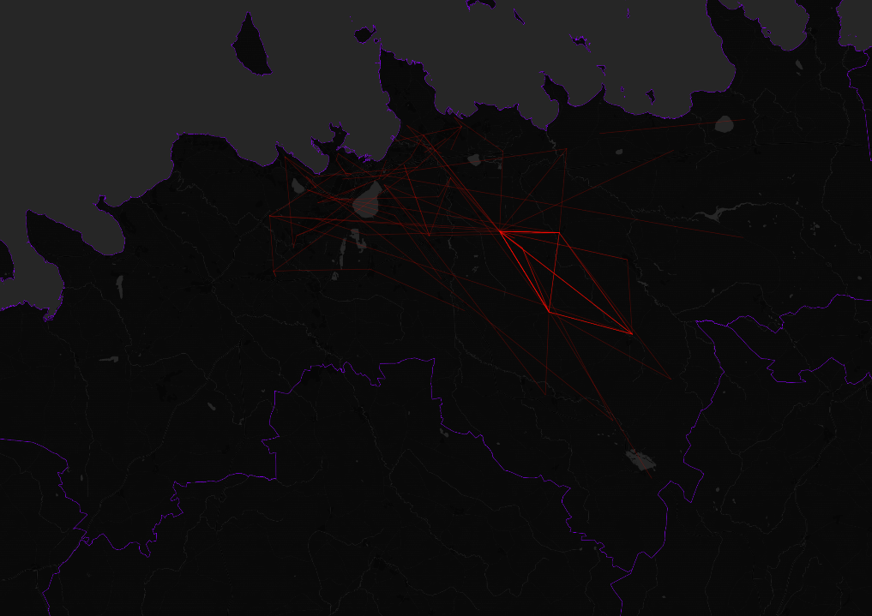
Tallinn : Weekend

